Slide 1
STA 640: Bayesian Non-Parametric Analysis of Heterogenous
Treatment Effects.
Devin Ti Tze Hong

Slide 2
Seeking a data - driven way of analysing Heterogenous Treatment Effect
Current approach to HTE analysis involves pre-specifying subgroups based on covariates and checking if estimated treatment effects differ across the subgroups.
Issue 1: Requires expert information.
Needs a medical / policy expert to identify important subgroups.
Issue 2: Are we missing potentially important subgroups.
Might miss out important subgroups if we are not apriori aware that they are important
Can we take a more data driven approach?
Notes:
Insert verbal comment not data driven?

Slide 3
Clustering as a way to identify subgroups.
Cluster analysis seems natural… But what do we cluster?
Some Possibilities
Potential Outcomes (Estimated)
Causal Clustering (Kim, K. (2020)). Clusters in the space of estimated potential outcomes.
These clusters cannot always be identified in the population since we have no observable covariates on them.
Covariates
Cluster covariates and then find run SGA after wards.
No guarantee that estimated clusters will have differing treatment effects.
Covariates and Outcomes
Using both is ideal, we get clusters that are separated by observable covariates, but still have difference in treatment effects.

Slide 4
Bayesian Non-parametric Regression lets us do both
We want to:
1) Cluster base on covariates + outcomes.
2) Model the outcomes
Ewens - Pitman Attraction (EPA) (Dahl, D. B., Day, R., & Tsai, J. W. (2017))
- Prior distribution over partitions of data points indexed by pairwise similarities between data points.
- Combining with a regression likelihood per cluster, produces a EPA regression model.
- Exactly what we need! Use covariates we wish to analyse HTE over in calculating similarity scores.
- Use regression per cluster to model outcomes.
- Points are clustered based on a balance between covariate similarity (partition prior) and treatment effect similarity (regression likelihood).

Slide 5
Bayesian Non-parametric Regression lets us do both
We want to:
1) Cluster base on covariates + outcomes.
2) Model the outcomes
Bayesian non-parametric models lets us do both.
Specify a prior over a partitions of the data
Within each partition model outcome ~ covariates + treatment.
Choose partition distributions which account for data point similarities.
Ewens - Pitman Attraction (EPA) (Dahl 2017)
- Distribution over partitions of data points indexed by pairwise similarities between data points.
- Combining with a regression likelihood per cluster, produces a EPA regression model.
- Exactly what we need. Use covariates we wish to analyse HTE over in calculating similarity scores.
- Use regression per cluster to model outcomes.
- Points are clustered based on a balance between covariate similarity (partition prior) and treatment effect similarity (regression likelihood).

Slide 6
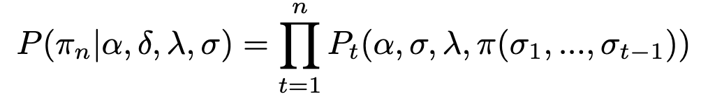
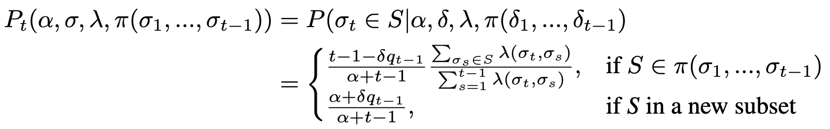
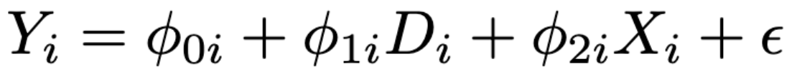
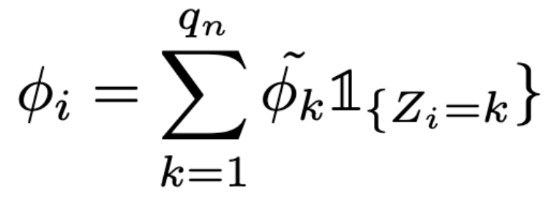
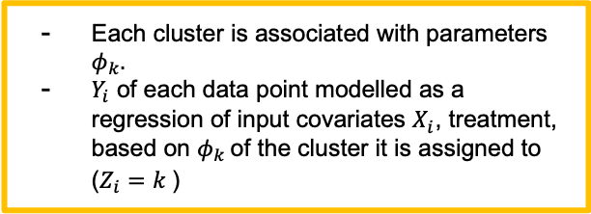
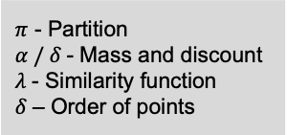
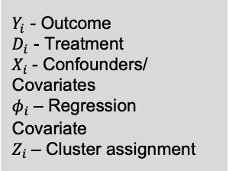
EPA Regression in Details
Partition Prior (EPA Distribution)
$π$ - Partition
$α / δ$- Mass and discount
$λ$- Similarity function
$δ$– Order of points
Points are assigned sequentially (based on order delta), to existing subsets based on attraction to the subset, as well as subset size.
Also a probability of being assigned to new clusters.
Combine with regression
Each cluster is associated with parameters $φ_{k}.$
$Y_{i}$ of each data point modelled as a regression of input covariates $X_{i}$, treatment, based on ${φ_{k}}_{ }$of the cluster it is assigned to ($Z_{i}=k$)
$Y_{i}$ - Outcome
$D_{i}$ - Treatment
$X_{i}$- Confounders/ Covariates
$φ_{i}$– Regression Covariate
$Z_{i}$– Cluster assignment
Inference can be conducted easily with Gibbs Sampling!

Slide 7
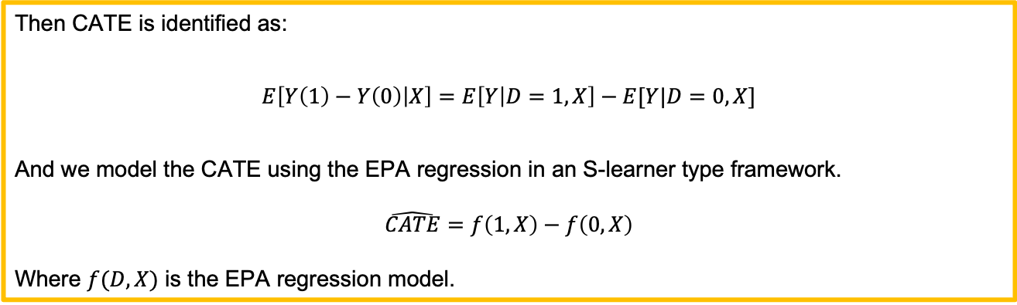
But what about causal assumptions?
We assume either randomized assignment or observation data. Several assumptions are needed to make the model valid for estimating causal effects.
SUTVA
Positivity
No un-measured confounding (for observation data)
Then CATE is identified as:
$$E\left[Y\left(1\right)−Y\left(0\right) | X\right]=E\left[Y | D=1,X\right]−E[Y|D=0,X]$$
And we model the CATE using the EPA regression in an S-learner type framework.
$$\hat{CATE}=f\left(1,X\right)−f\left(0,X\right)$$
Where $f(D,X)$ is the EPA regression model.

Slide 8
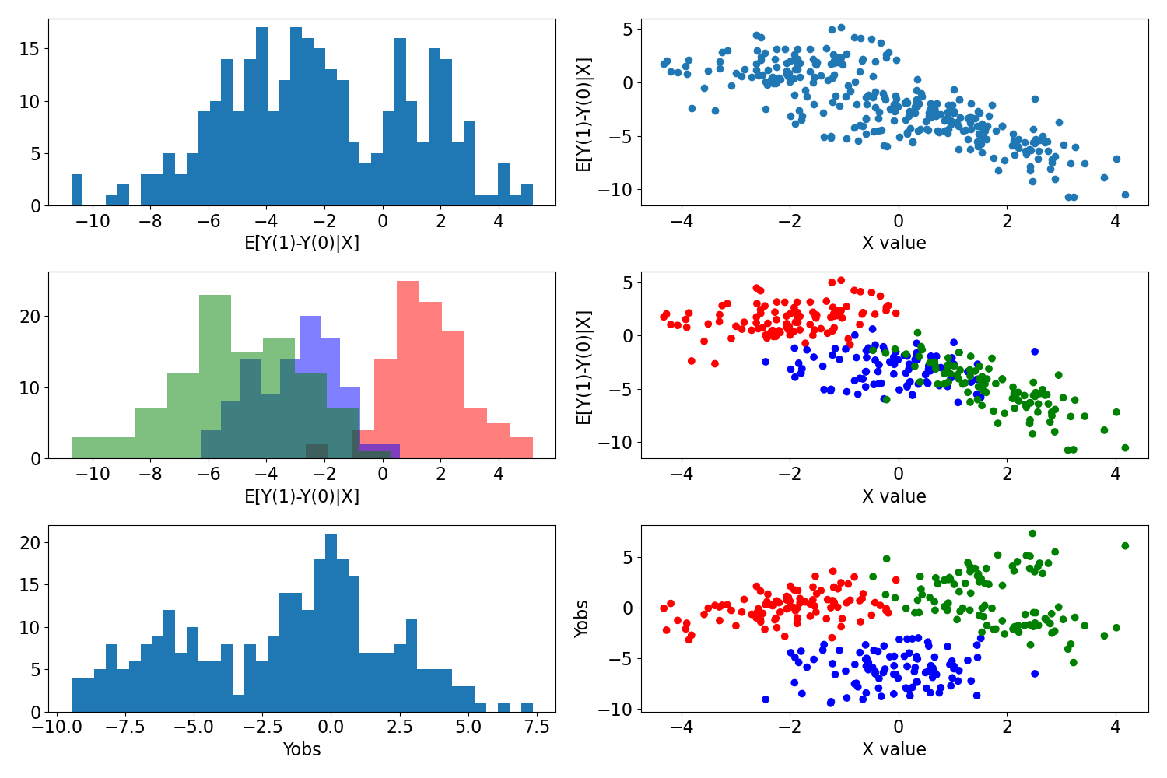
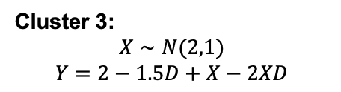
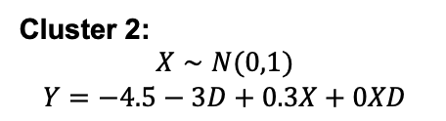
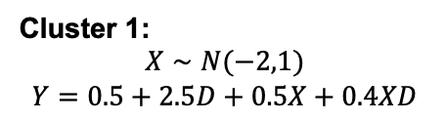
Testing method on simulated data
We simulate a dataset consisting of 3 latent clusters, with 3 associated regression functions.
Cluster 1:
$$X∼N(−2,1)$$
$$Y=0.5+2.5D+0.5X+0.4XD$$
Cluster 2:
$$X∼N(0,1)$$
$$Y=−4.5−3D+0.3X+0XD$$
Cluster 3:
$$X∼N(2,1)$$
$$Y=2−1.5D+X−2XD$$
Fig 1: Histograms and Scatter Plots of Simulated Data

Slide 9
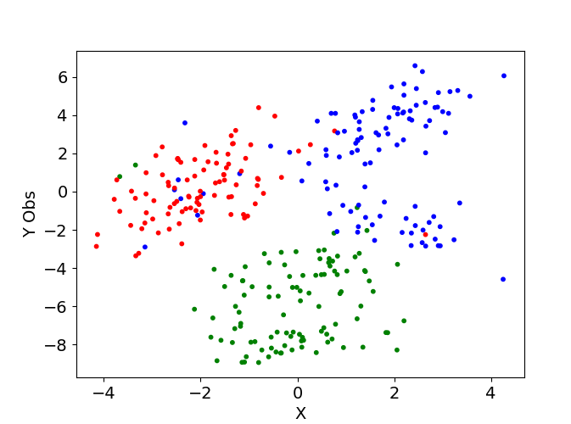
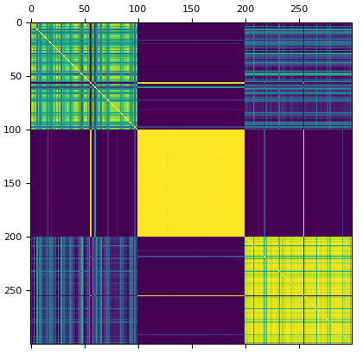
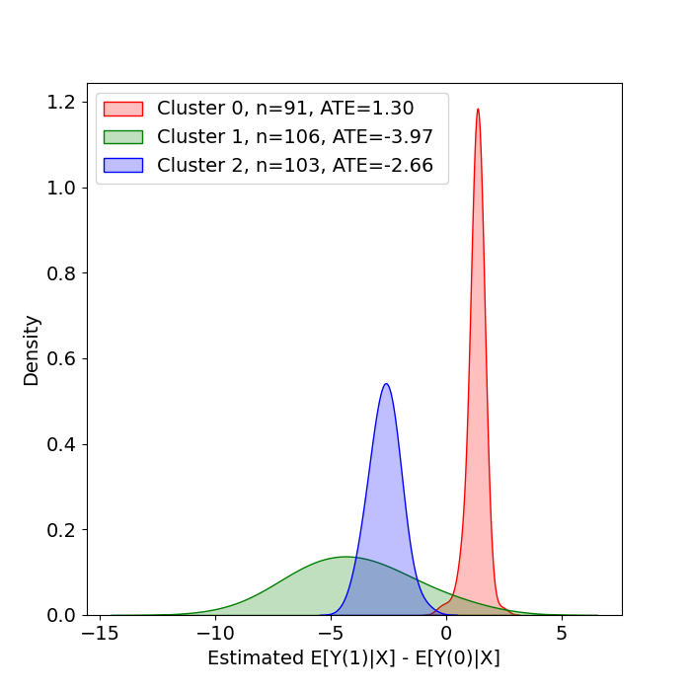
EPA Regression is able to recover latent clusters and treatment effects
Re-Cluster with Hierarchical Clustering (Medvedovic, M., Yeung, K. Y., & Bumgarner, R. E. (2004))
Fig 3: Scatter Plot Observed Y – X, with estimated clusters (Simulated Data)
Estimating per cluster treatment effects (S-Learner Approach)
Fig 2: Posterior Similarity Matrix (Simulated Data)
Use MCMC samples to construct a posterior similarity matrix.
Fig 4: Estimated Treatment Effect Per Cluster (Simulated Data)

Slide 10
We Further Test On Real Data…
- National Supported Work Demonstration (NSW) Dataset
Consists of 405 individuals randomly assigned to a job training program, with income at the end (1978) measured.
Covariates consist of demographic information, education levels, and pre-treatment income levels.
Used demographic and education levels to get similarities.

Slide 11
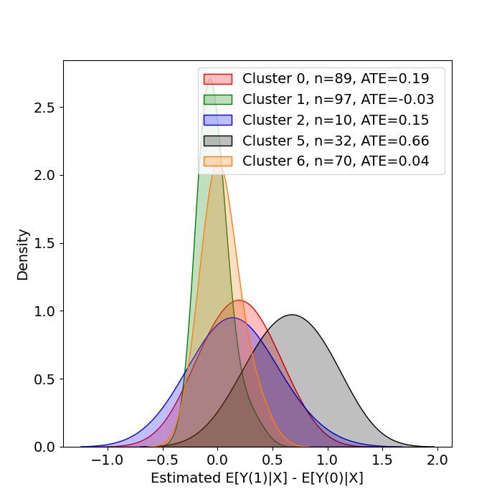
We find the presence of clusters with heterogenous effects
Cluster No. | 0 | 1 | 2 | 5 | 6 | All
Effect | 193.17 | -34.14 | 146.67 | 661.50 | 39.76 | 1340.84
Model finds 5 clusters with differing estimated treatment effects
Need to further analyse covariates to see how these groups can be identified based on observable information
Fig 5: Estimated Treatment Effect Per Cluster (NSW Data)

Slide 12
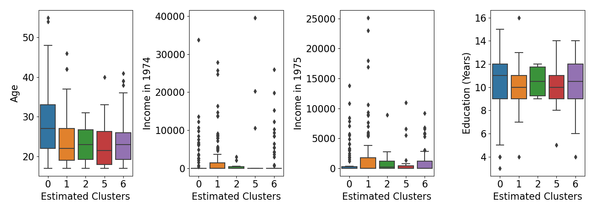
However, these clusters are not well separated on observable information
Fig x: Boxplots of per cluster continuous covariates (NSW Data)
We find that the clusters are generally not well separated on demographic information. Both continuous and categorical.
This implies that uncovered heterogeneity is not operationalizable.

Slide 13
Conclusion
EPA regression provides an alternative to conducting HTE analysis.
Clusters (Subgroups) formed by a mix of 1) Covariate Similarity 2) Similarity in output – covariate relation. Thus, giving a way to find HTE by clustering.
Experiments on simulated data show that it is able to recover latent clusters with HTE (when present), whereas experiments on real data show that sometimes such inferred clusters might not be interpretable.
References
David B Dahl, Ryan Day, and Jerry W Tsai. “Random partition distribution indexed by pairwise information”. In: Journal of the American Statistical Association 112.518 (2017), pp. 721–732.
Kwangho Kim. “Causal Inference with Complex Data Structures and Non-Standard Effects”. PhD thesis. Carnegie Mellon University, 2020.
Mario Medvedovic, Ka Yee Yeung, and Roger Eugene Bumgarner. “Bayesian mixture model based clustering of replicated microarray data”. In: Bioinformatics 20.8 (2004), pp. 1222–1232.

Slide 14
Thank You!

